Slide 1

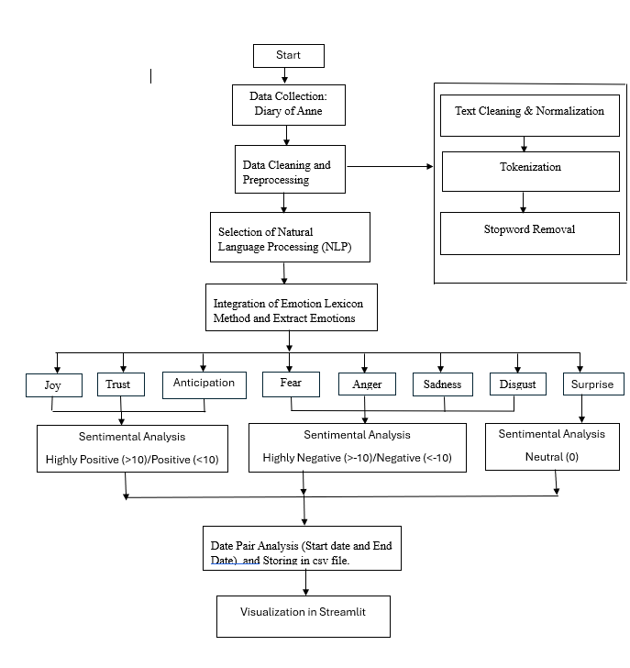
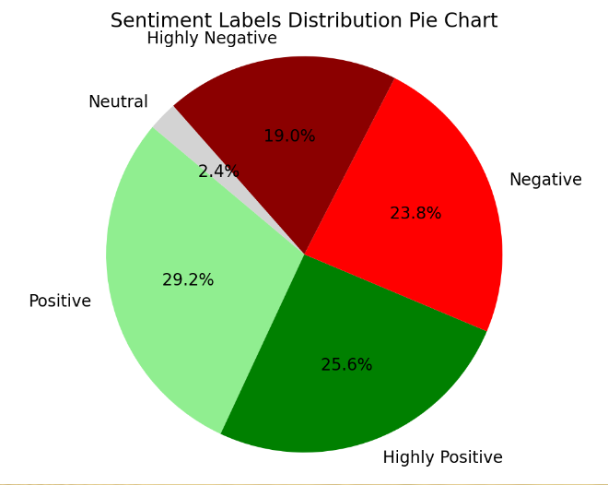
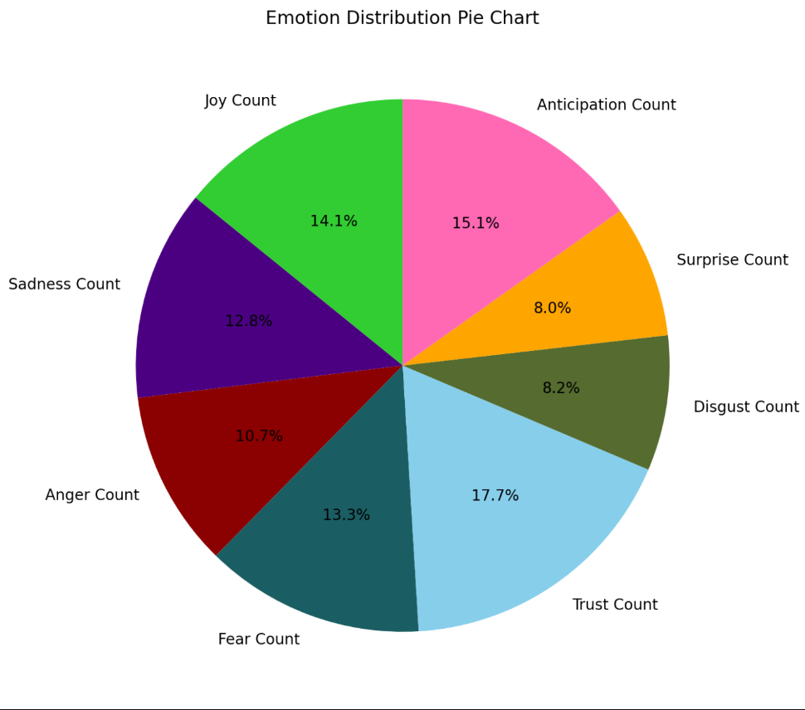

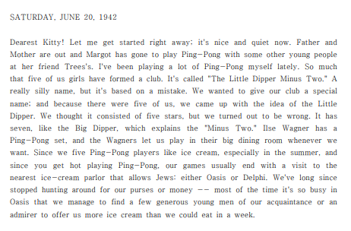

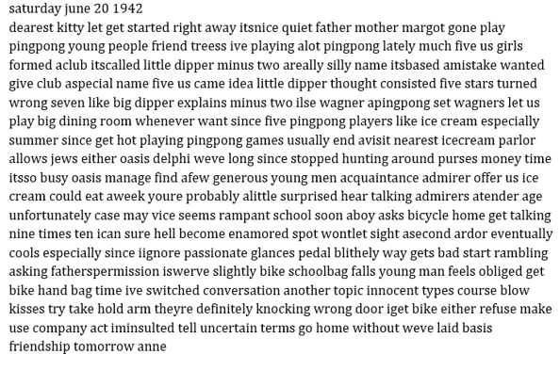
Sentiment Analysis of Cultural Heritage Texts:
Anne Frank Diary of Young Girl
By: Smita Sanjay Pable
Advisor: Christina Moir
Introduction
Flow Chart of Sentiment Analysis
Visualization
zx
In the digital age, the fusion of natural language processing (NLP) techniques with historical texts, exemplified by Anne Frank's diary, unveils the emotional depths of human history. Anne's diary, a poignant testament to resilience amidst adversity, reveals her innermost thoughts and struggles. Leveraging NLP algorithms and the NRC Emotion Lexicon, sentiment analysis uncovers the subtle nuances of Anne's emotions. Streamlit aids in visualizing the data, offering insights into Anne's quiet bravery and fleeting moments of beauty.
The analysis transcends individual sentiments, exploring the temporal ebbs and flows of emotions during pivotal historical events, Anne's bravery resonates across generations, and her strength is a guiding light.. Ultimately, this study enriches our understanding of cultural heritage and the enduring power of human resilience.
Sentimental Labels Distribution Pie chart
Emotion Distribution Pie chart
Preprocessing and Data Cleaning
Methodology for Sentiment Analysis and Emotion Extraction
The text preprocessing stage focuses on eliminating unnecessary characters and symbols, removing non-linguistic content such as dates and numbers, and filtering out stop words to facilitate meaningful analysis. Afterwards, the text is tokenized into discrete words for further analysis.
- Results:
Data Collection: Obtaining Anne Frank's diary entries.
Text Preprocessing: Cleaning and formatting the text data for analysis.
NRC Emotion Lexicon Loading: Load the NRC Emotion Lexicon containing words labeled with emotions and sentiment ratings.
Sentiment Score Calculation and Labeling: Determine sentiment scores by calculating the difference between positive and negative emotions and label sentiments into discrete categories.
Date Pair Analysis: Identify date pairings in the diary text to analyze sentiment and emotion trends over time.
CSV Data Export: Save extracted emotions and sentiment scores in a CSV file for further analysis.
Visualization in Streamlit.
Conclusion
Analyzing Anne Frank's diary sentimentally has allowed us to see the emotional journey of a young girl living through one of the saddest periods in human history. Through close reading and visualization of her journal entries, we have been able to uncover the complex dynamics of her feelings, which included both profound sadness and worry as well as happy and hopeful moments.
This investigation has not only enriched our comprehension of Anne's personal challenges and determination but has also provided a glimpse into the wider experience of humanity during the genocide.
References
• Bird, S., Klein, E., & Loper, E. (2009). Natural Language Processing with Python. O'Reilly Media, Inc.
• Jurafsky, D., & Martin, J. H. (2019). Speech and Language Processing (3rd ed.). Pearson.
• Manning, C. D., Raghavan, P., & Schütze, H. (2020). Introduction to Information Retrieval. Cambridge University Press.
• Mohammad, S. M., & Turney, P. D. (2010). Emotions Evoked by Common Words and Phrases
• https://www.docdroid.net/N8uGQ0o/anne-frank-the-diary-of-a-young-girl-pdf

